Slide 1
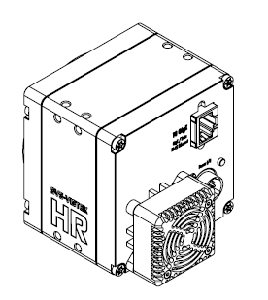
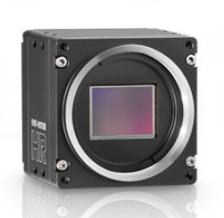
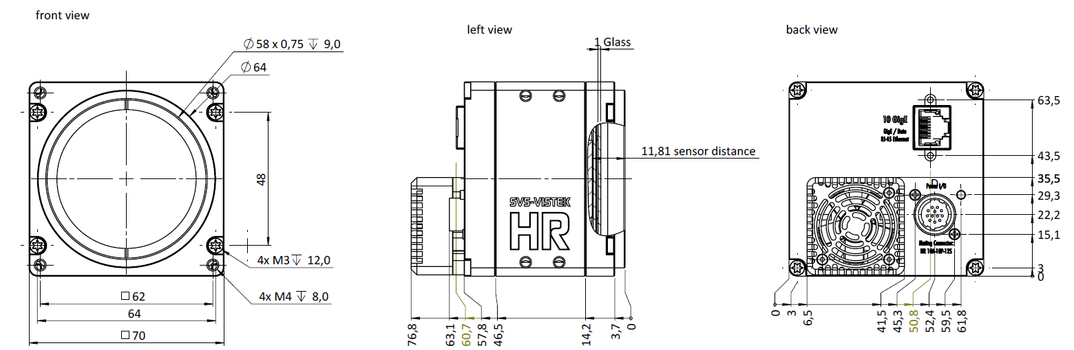
TYPE 1
Sensor Size : 38.75mm x 27.75mm

Slide 2
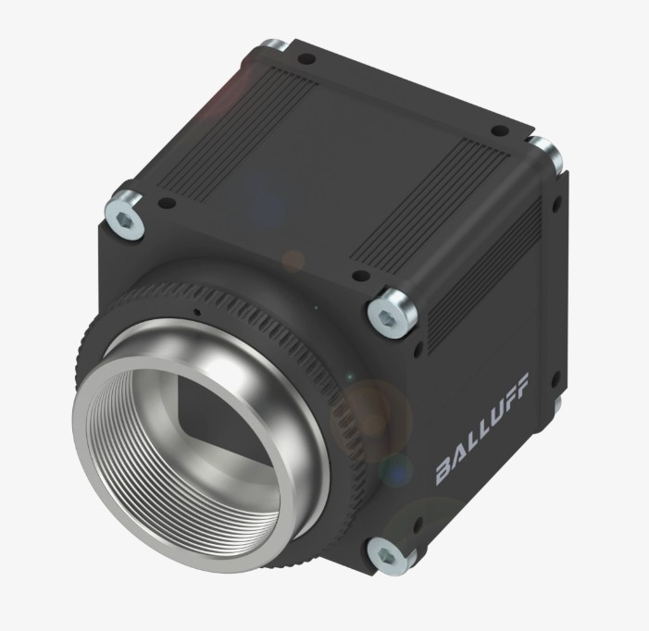
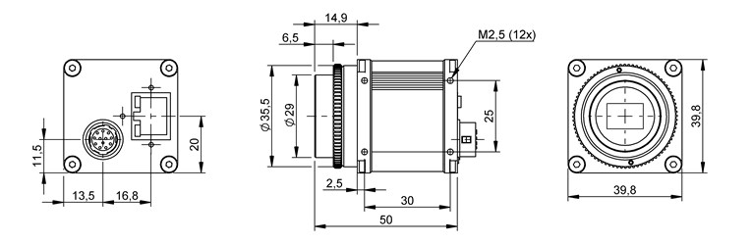
TYPE 2
Sensor Size : 7.5mm x 7.5mm
Sensor distance 17.4mm

